Slide 1
Factors Affecting the Sale Price of Condominium Units Sold at Public Auction
Traci Pflaum
May 1, 2013
STAT 512

Slide 2
Objective
Our objective is to show how regression analysis can be used to develop a model relating sales price of condominium units to a set of independent variables, and to show how the model can be used to reveal some interesting relationships among these variables

Slide 3
The Problem
The sales data were obtained in 1979 for a new ocean side condominium complex consisting of two adjacent and connected buildings with eight floors each. The complex has 200 units of equal size. The building of the complex was finished during a recession, so the units were auctioned off. The units that weren’t sold were furnished and rented. Furthermore, the prices were entirely buyer-specified and hence, consumer oriented. Because of this, our data is specific to our problem—essentially, the price paid was the price the consumer thought was adequate for the commodities each unit supplied.

Slide 4
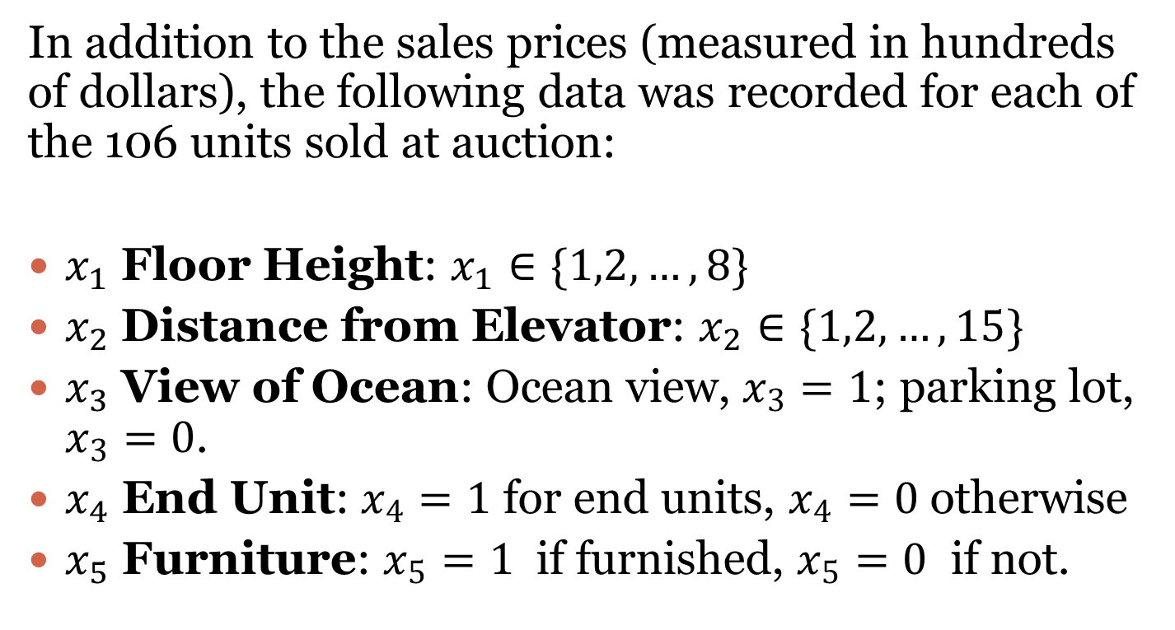
The Data
In addition to the sales prices (measured in hundreds of dollars), the following data was recorded for each of the 106 units sold at auction:
$x_{1}$ Floor Height: $x_{1}∈\{1,2,…,8\}$
$x_{2}$Distance from Elevator: $x_{2}∈\{1,2,…,15\}$
$x_{3}$ View of Ocean: Ocean view, $x_{3}=1$; parking lot, $x_{3}=0$.
$x_{4}$ End Unit: $x_{4}=1$ for end units, $x_{4}=0$ otherwise
$x_{5}$ Furniture: $x_{5}=1$ if furnished, $x_{5}=0$ if not.

Slide 5
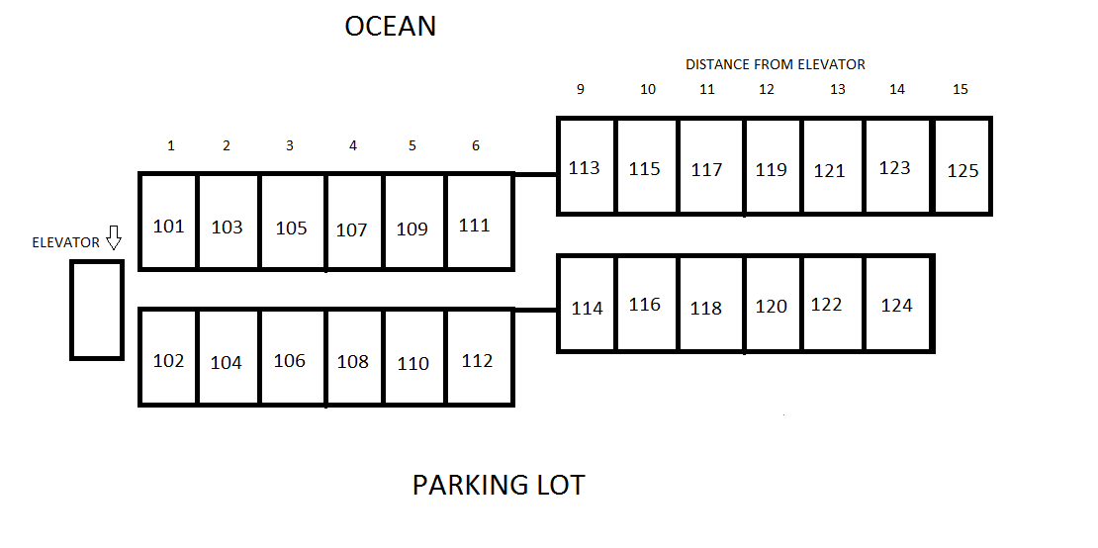
Layout Diagram

Slide 6
Independent Variables
Note that our case involves five independent variables.
Two of these are quantitative (floor height and distance from elevator).
Three are qualitative (view of ocean, end unit, and furniture).

Slide 7
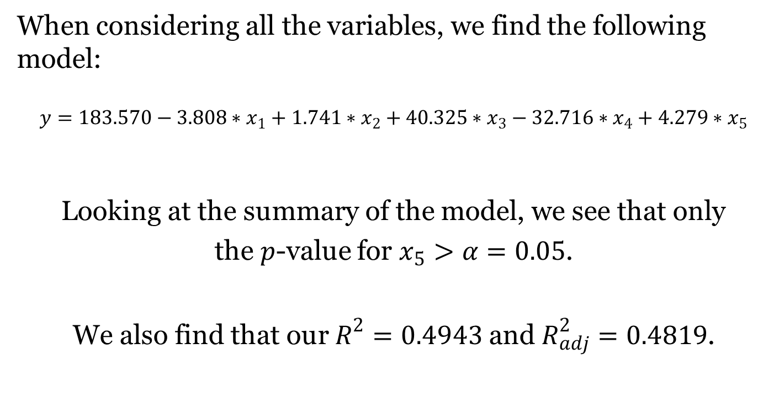
Full Model
When considering all the variables, we find the following model:
$$y=183.570−3.808∗x_{1}+1.741∗x_{2}+40.325∗x_{3}−32.716∗x_{4}+4.279∗x_{5}$$
Looking at the summary of the model, we see that only
the $p$-value for $x_{5}>α=0.05$.
We also find that our $R^{2}=0.4943$ and $R_{adj}^{2}=0.4819$.

Slide 8
Variance Inflation Factors
x1 x2 x3 x4 x5
1.012436 1.042262 1.047818 1.043729 1.029194
Since all of our VIF values are less than 2, we can deduce that no serious multicollinearity problems exist.

Slide 9
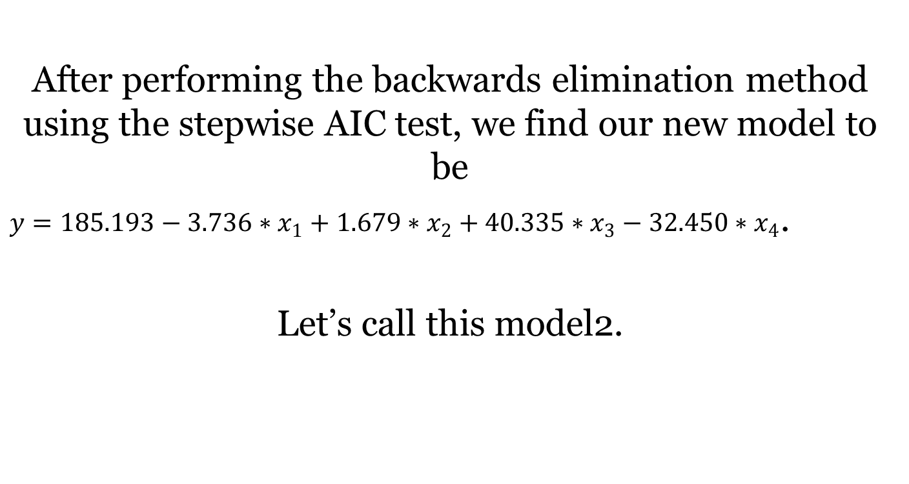
Stepwise Regression: Backwards Elimination
After performing the backwards elimination method using the stepwise AIC test, we find our new model to be
$y=185.193−3.736∗x_{1}+1.679∗x_{2}+40.335∗x_{3}−32.450∗x_{4}$.
Let’s call this model2.

Slide 10
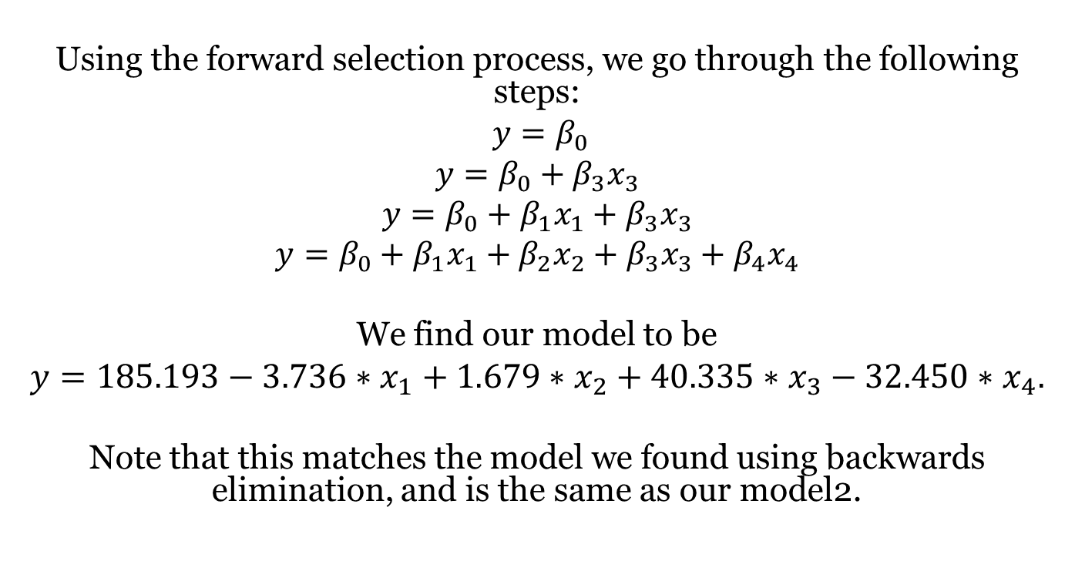
Stepwise Regression: Forward Selection
Using the forward selection process, we go through the following steps:
$$y=β_{0}$$
$$y=β_{0}+β_{3}x_{3}$$
$$y=β_{0}+β_{1}x_{1}+β_{3}x_{3}$$
$$y=β_{0}+β_{1}x_{1}+β_{2}x_{2}+β_{3}x_{3}+β_{4}x_{4}$$
We find our model to be
$y=185.193−3.736∗x_{1}+1.679∗x_{2}+40.335∗x_{3}−32.450∗x_{4}.$
Note that this matches the model we found using backwards elimination, and is the same as our model2.

Slide 11
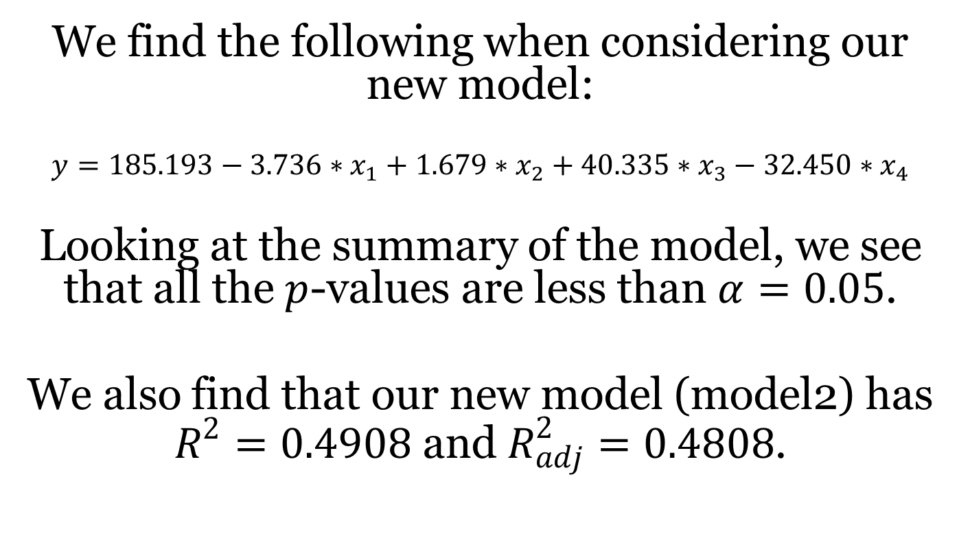
Model 2
We find the following when considering our new model:
$$y=185.193−3.736∗x_{1}+1.679∗x_{2}+40.335∗x_{3}−32.450∗x_{4}$$
Looking at the summary of the model, we see that all the $p$-values are less than $α=0.05$.
We also find that our new model (model2) has $R^{2}=0.4908$ and $R_{adj}^{2}=0.4808$.

Slide 12
Confidence Intervals for Model 2
Furthermore, we find the following 95% confidence intervals for our model:
> confint(model2,level=.95)
2.5 % 97.5 %
(Intercept) 175.2484319 195.137913
x1 -5.2078384 -2.264059
x2 0.9464422 2.412165
x3 33.5129064 47.156537
x4 -51.3548256 -13.544476

Slide 13
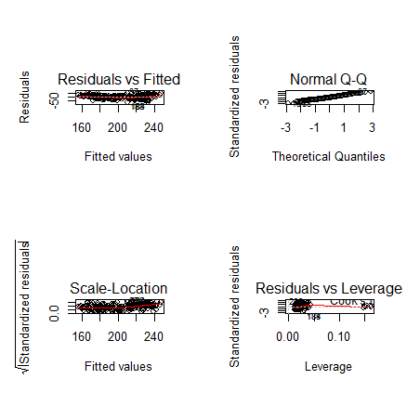
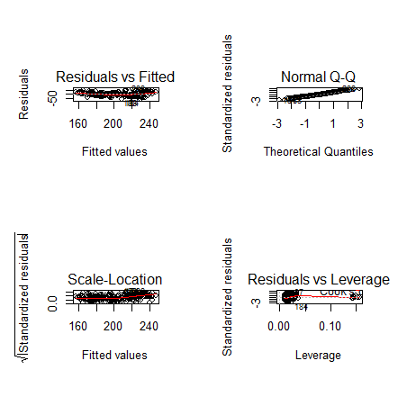
Plot of the Residuals: Full Model vs. Model 2
Full Model Model 2

Slide 14
Comparing AIC and BIC Values
AIC(fullmodel) AIC(model2)
[1] 1936.266 [1] 1935.714
BIC(fullmodel) BIC(model2)
[1] 1959.663 [1] 1955.768
Comparing our AIC and BIC values from our full model to our new model (model2), we see that both our AIC and BIC values decrease slightly when switching to our new model.

Slide 15
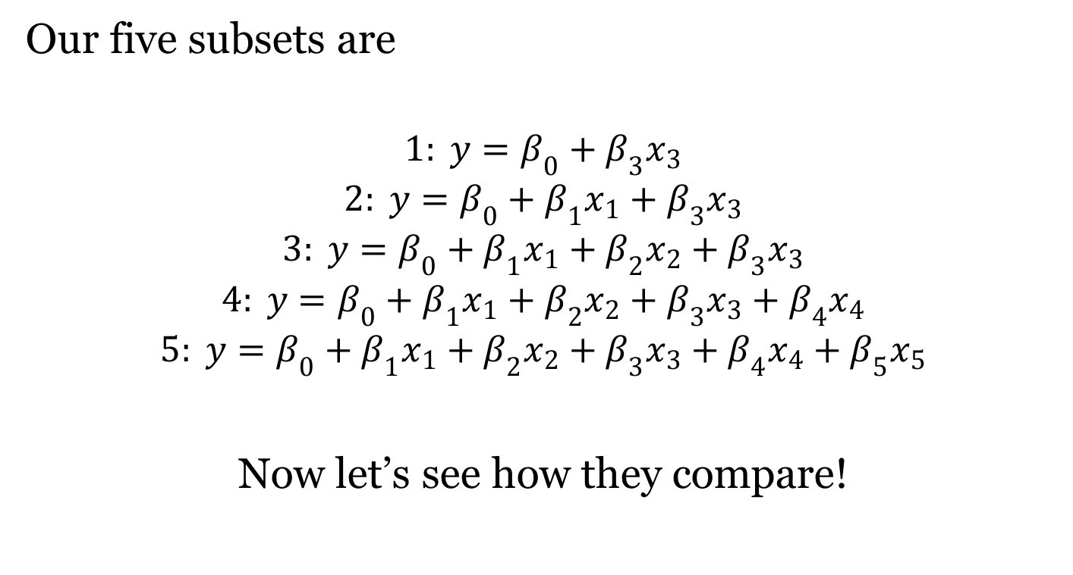
Best Subsets Analysis
Our five subsets are
$$1: y=β_{0}+β_{3}x_{3}$$
$$2: y=β_{0}+β_{1}x_{1}+β_{3}x_{3}$$
$$3: y=β_{0}+β_{1}x_{1}+β_{2}x_{2}+β_{3}x_{3}$$
$$4: y=β_{0}+β_{1}x_{1}+β_{2}x_{2}+β_{3}x_{3}+β_{4}x_{4}$$
$$5: y=β_{0}+β_{1}x_{1}+β_{2}x_{2}+β_{3}x_{3}+β_{4}x_{4}+β_{5}x_{5}$$
Now let’s see how they compare!

Slide 16
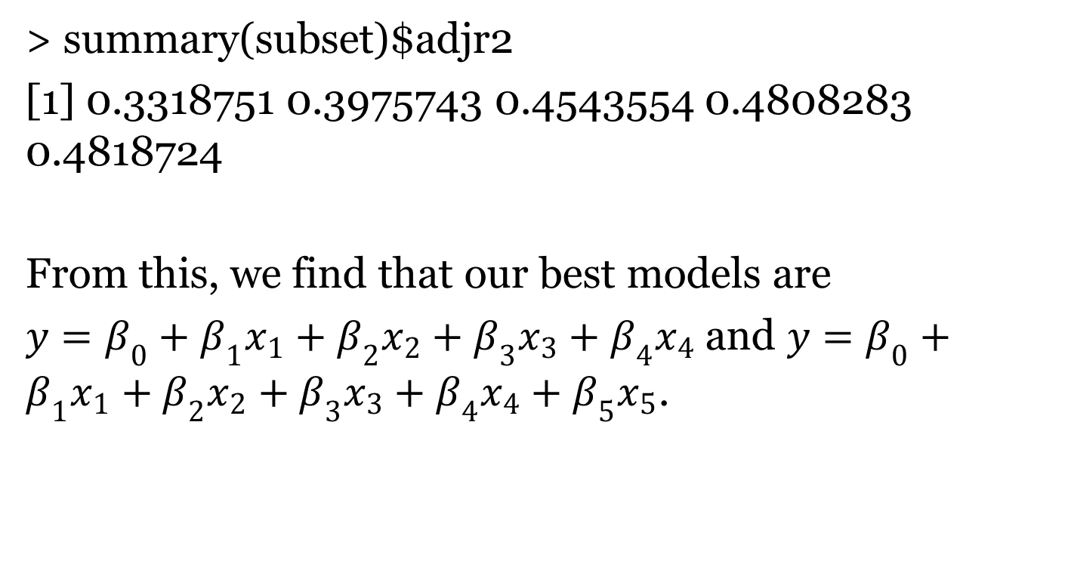

${R^{2}}_{adj}^{ }$ Test
> summary(subset)$adjr2
[1] 0.3318751 0.3975743 0.4543554 0.4808283 0.4818724
From this, we find that our best models are
$y=β_{0}+β_{1}x_{1}+β_{2}x_{2}+β_{3}x_{3}+β_{4}x_{4}$and $y=β_{0}+β_{1}x_{1}+β_{2}x_{2}+β_{3}x_{3}+β_{4}x_{4}+β_{5}x_{5}$.

Slide 17
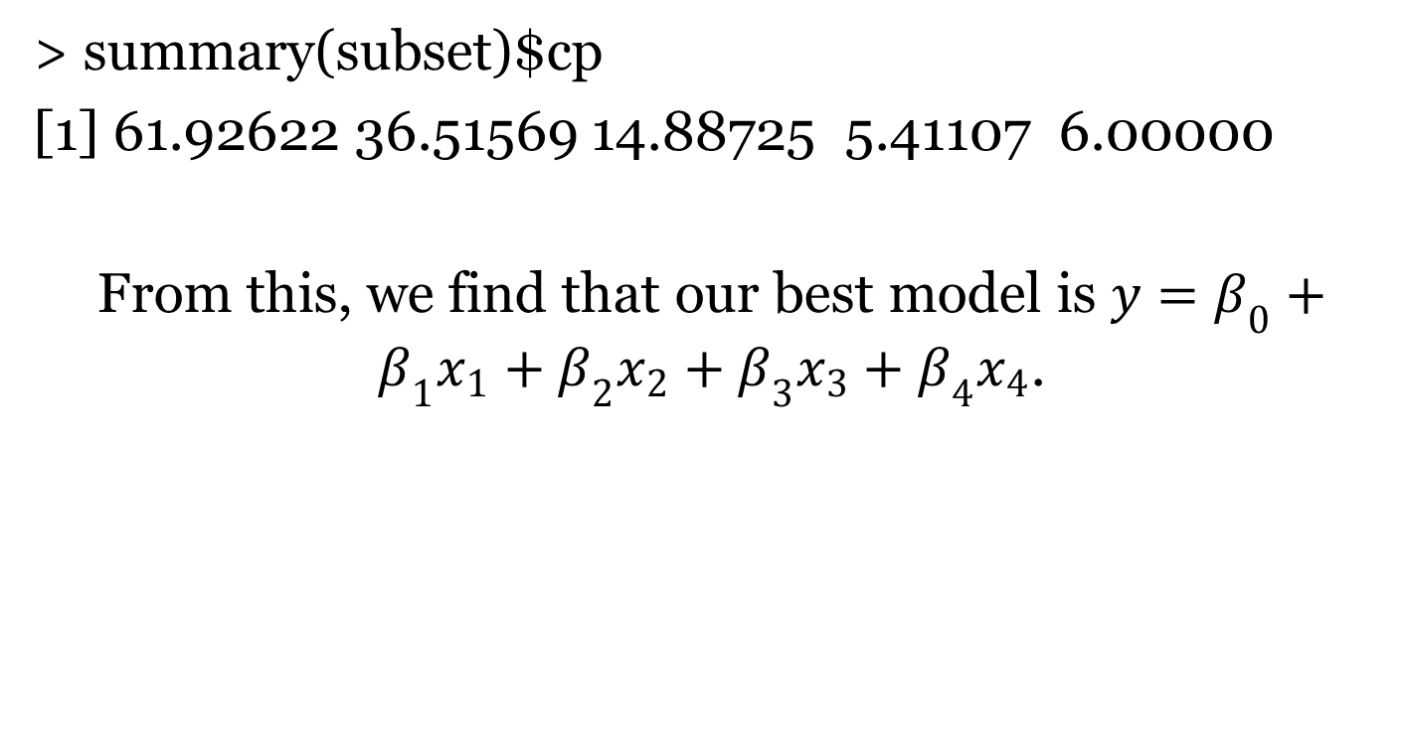

$C_{p}$Test
> summary(subset)$cp
[1] 61.92622 36.51569 14.88725 5.41107 6.00000
From this, we find that our best model is $y=β_{0}+β_{1}x_{1}+β_{2}x_{2}+β_{3}x_{3}+β_{4}x_{4}$.

Slide 18
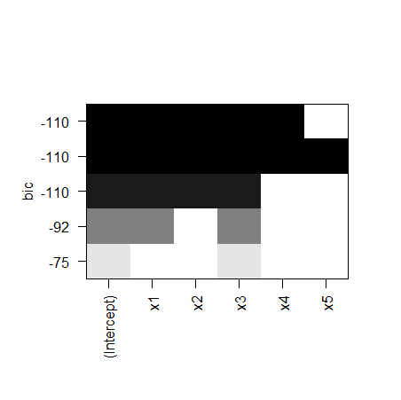
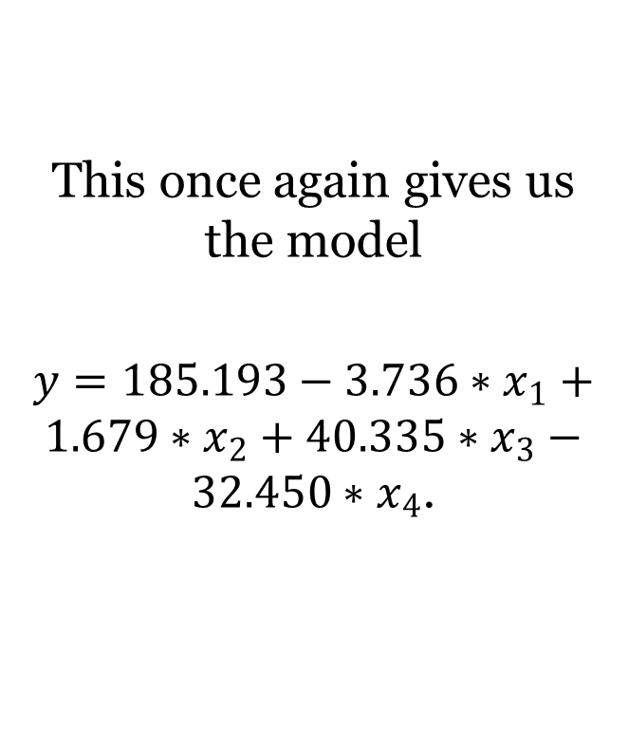
Subsets BIC Criterion
This once again gives us the model
$y=185.193−3.736∗x_{1}+1.679∗x_{2}+40.335∗x_{3}−32.450∗x_{4}$.

Slide 19
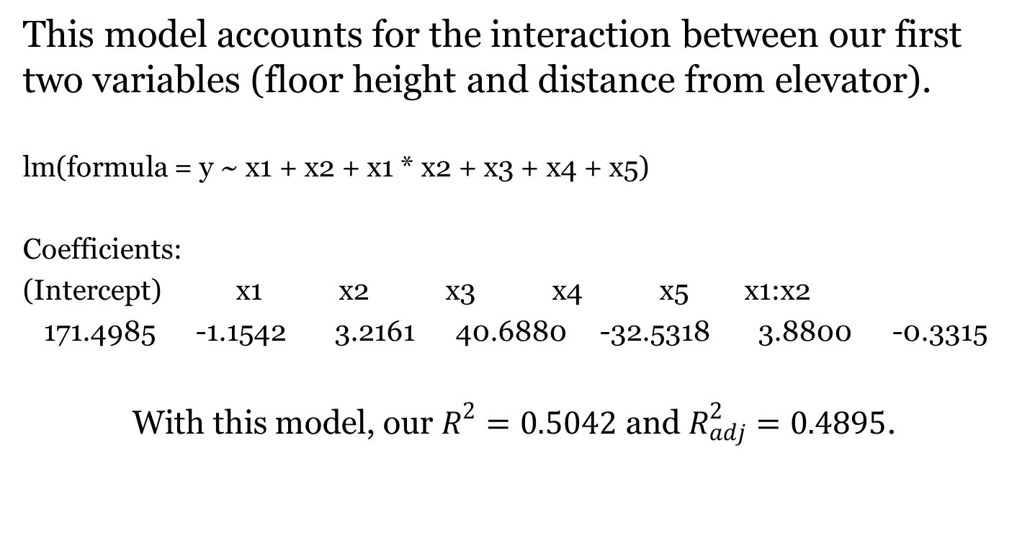
A Quick Discussion of Other (More Complex) Models
This model accounts for the interaction between our first two variables (floor height and distance from elevator).
lm(formula = y ~ x1 + x2 + x1 * x2 + x3 + x4 + x5)
Coefficients:
(Intercept) x1 x2 x3 x4 x5 x1:x2
171.4985 -1.1542 3.2161 40.6880 -32.5318 3.8800 -0.3315
With this model, our $R^{2}=0.5042$ and $R_{adj}^{2}=0.4895$.

Slide 20
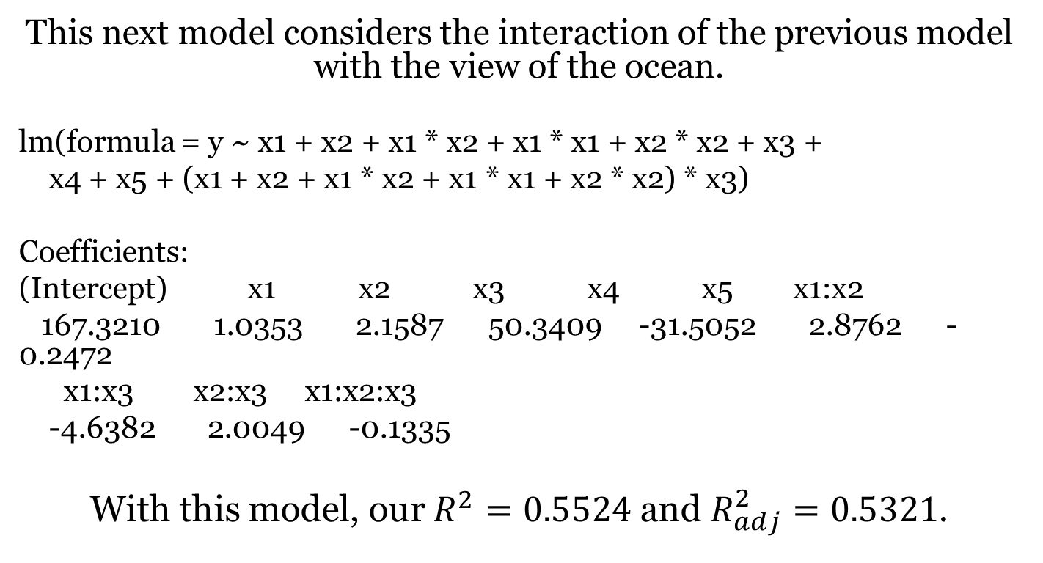
Further Discussion of Other (More Complex) Models
This next model considers the interaction of the previous model with the view of the ocean.
lm(formula = y ~ x1 + x2 + x1 * x2 + x1 * x1 + x2 * x2 + x3 +
x4 + x5 + (x1 + x2 + x1 * x2 + x1 * x1 + x2 * x2) * x3)
Coefficients:
(Intercept) x1 x2 x3 x4 x5 x1:x2
167.3210 1.0353 2.1587 50.3409 -31.5052 2.8762 -0.2472
x1:x3 x2:x3 x1:x2:x3
-4.6382 2.0049 -0.1335
With this model, our $R^{2}=0.5524$ and $R_{adj}^{2}=0.5321$.

Slide 21
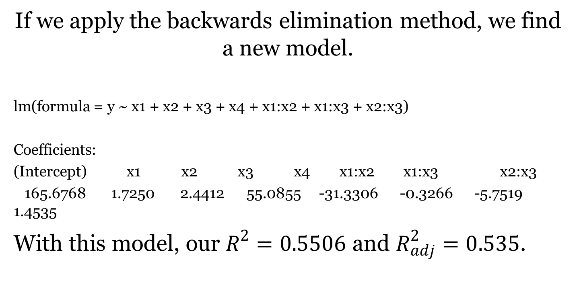
Applying Backwards Elimination to the Previous Model
If we apply the backwards elimination method, we find a new model.
lm(formula = y ~ x1 + x2 + x3 + x4 + x1:x2 + x1:x3 + x2:x3)
Coefficients:
(Intercept) x1 x2 x3 x4 x1:x2 x1:x3 x2:x3
165.6768 1.7250 2.4412 55.0855 -31.3306 -0.3266 -5.7519 1.4535
With this model, our $R^{2}=0.5506$ and $R_{adj}^{2}=0.535$.

Slide 22
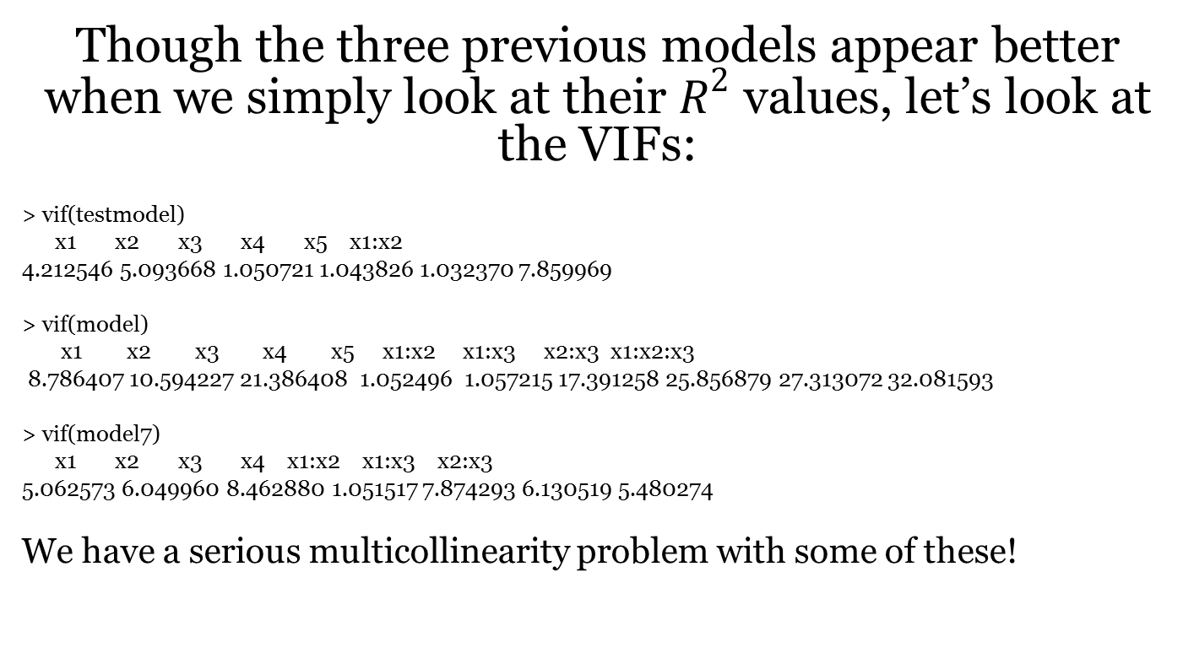
Further Examination of Our New Models
Though the three previous models appear better when we simply look at their $R^{2}$ values, let’s look at the VIFs:
> vif(testmodel)
x1 x2 x3 x4 x5 x1:x2
4.212546 5.093668 1.050721 1.043826 1.032370 7.859969
> vif(model)
x1 x2 x3 x4 x5 x1:x2 x1:x3 x2:x3 x1:x2:x3
8.786407 10.594227 21.386408 1.052496 1.057215 17.391258 25.856879 27.313072 32.081593
> vif(model7)
x1 x2 x3 x4 x1:x2 x1:x3 x2:x3
5.062573 6.049960 8.462880 1.051517 7.874293 6.130519 5.480274
We have a serious multicollinearity problem with some of these!

Slide 23
Concluding
Recall the principle of parsimony: the principle that entities should not be multiplied needlessly; the simplest of two competing theories is to be preferred.

Slide 24
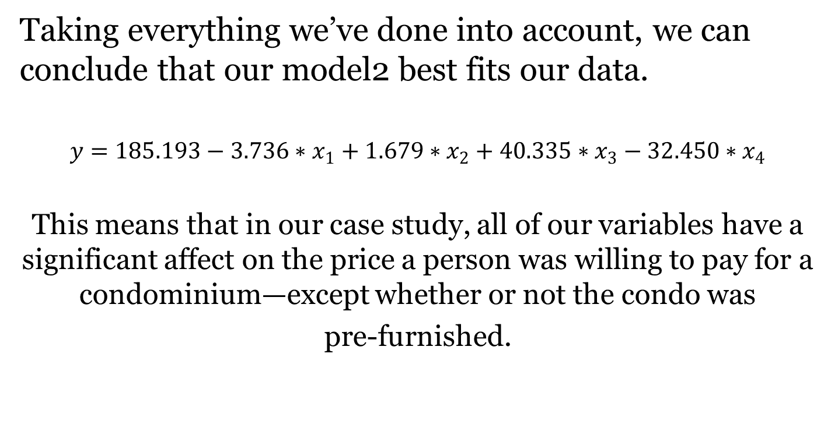
Conclusion
Taking everything we’ve done into account, we can conclude that our model2 best fits our data.
$$y=185.193−3.736∗x_{1}+1.679∗x_{2}+40.335∗x_{3}−32.450∗x_{4}$$
This means that in our case study, all of our variables have a significant affect on the price a person was willing to pay for a condominium—except whether or not the condo was
pre-furnished.

Slide 25
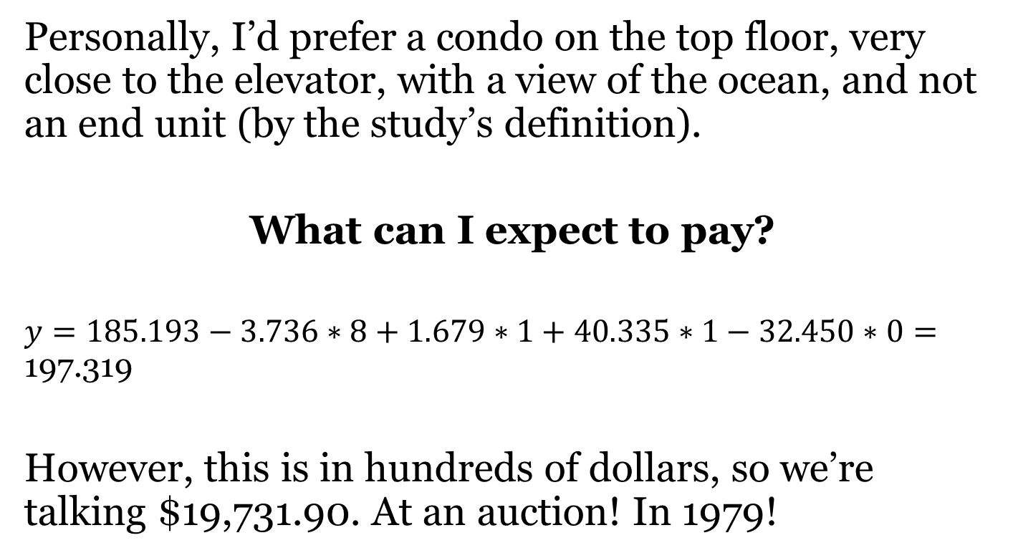
Now Let’s Predict!
Personally, I’d prefer a condo on the top floor, very close to the elevator, with a view of the ocean, and not an end unit (by the study’s definition).
What can I expect to pay?
$y=185.193−3.736∗8+1.679∗1+40.335∗1−32.450∗0=$ 197.319
However, this is in hundreds of dollars, so we’re talking $19,731.90. At an auction! In 1979!

Slide 26
We’ve reached the end!
Questions?
Comments?
Concerns?

